Slide 1

Internationalize your web applications using
Wikimedia i18n libraries
Santhosh Thottingal
Wikimedia Foundation

Slide 2
/me
Software Engineer at
the Wikimedia Foundation
Language Engineering team
FOSS developer specialized in Indic language computing

Slide 3
i18n...?
Internationalization
18 letters
Making an application multilingual and ready for localizing to other languages

Slide 4
i18n
Externalize all interface strings so that they can be translated to other languages
Also avoid any assumptions that are valid only for English

Slide 5
<span data-i18n='app-name-label'></span>
<input type='text'></input>
<span data-i18n='app-name-label'></span>
<input type='text'></input>
HTML
{
'en' : {
'app-name-label' : "Enter your name:"
},
'ml': {
'app-name-label' : "നിങ്ങളുടെ പേരു്:"
}
}
Messages
Enter your name:
screen
നിങ്ങളുടെ പേരു്:

Slide 6
Is it that simple?
Found 1 result(s)
Found 1 results
var result = "Found " + count ;
if ( count === 1 ) {
result = result + " result";
} else {
result = result + " results";
}
}
Wrong
go to grammar school :)
}
OK?
But...

Slide 7
* Many languages have more than 2 plural forms
Arabic has 6 plural forms
* String concatenation assumes English sentence formation syntax
Found 6 results
5 परिणाम मिला
* You know only a few languages
* Your web application is not a language processing application

Slide 8
Not just plural
Meera changed his/her picture - Wrong
Meera changed her picture
Arun changed his picture
Many languages change the verb based on the gender of the subject.
E.g. Hindi

Slide 9
Numbers
हिन्दी विकिपीडियाका शुभारम्भ जुलाई २००३ में हुआ।
Decimal places
De Nederlandstalige Wikipedia telt op dit moment 1.121.894 artikelen
...

Slide 10
jquery.i18n

Slide 11
JavaScript internationalization library
Supporting 300+ languages
Well tested by the Wikimedia community
Open source
Developed and maintained by Wikimedia Language engineering team

Slide 12
jquery.i18n features:
* placeholders (a.k.a. variables or parameters)
* plural forms
* gender
* grammar (custom for every language)
* digit transformations
* language fallbacks ( Maithili -> Hindi-> English )

Slide 13
Developers
<div id='car' data-i18n='app-cars'></div>
and in messages
'app-car' : "car"
Translators
ml: { "app-car" : "കാര്‍" },
ta: { "app-car" : "கார்" }
...
And
$(document).i18n();
Readers see the page in their prefered language.

Slide 14
Developers
<div id='car' data-i18n='app-cars'></div>
messages(en.json)
'app-cars' : "$1{{plural:$1|car|cars}}"
Translators
ml: { "app-cars" : "$1 {{plural:$1|കാര്‍|കാറുകൾ}}" },
ta: { "app-cars" : "$1 {{plural:$1|கார்|கார்கள்}}" },
he: { "app-cars" : "$1 {{plural:$1|מכונית|מכוניות}}" }
...
$(document).i18n();
And depending on the page's language, readers get grammatically correct messages.

Slide 15
Live example

Slide 16
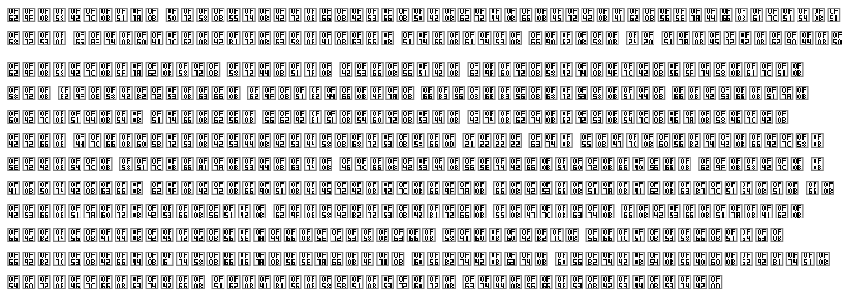
Internationalized, but...
Are we sure that the readers have all the needed fonts on their machines?

Slide 17
jquery.webfonts
A webfonts library with a focus on non-Latin text readability and accessibility
Largest open licensed font repository
70+ fonts in 20+ scripts

Slide 18
1..2..3
1. Annotate your HTML elements with lang attributes
<div lang="hi" class="container">...</div>
2. Apply webfonts to the document
$(document).webfonts();
3. jquery.webfonts make sure that readers get the content with webfonts for the marked language.
No more squares or question marks with missing fonts

Slide 19
I can read, now how can I write?
Typing in non-Latin languages is difficult for users.
Their systems might not have input methods or be properly configured.
Do you know how to type in your mother tongue?

Slide 20
jquery.ime
* A library to power web applications with input methods
* Over 140+ input methods in many languages
* Deployed and tested in many wikis

Slide 21
jquery.ime
* A library to power web applications with input methods
* Over 140+ input methods in many languages
* Deployed and tested in many wikis

Slide 22
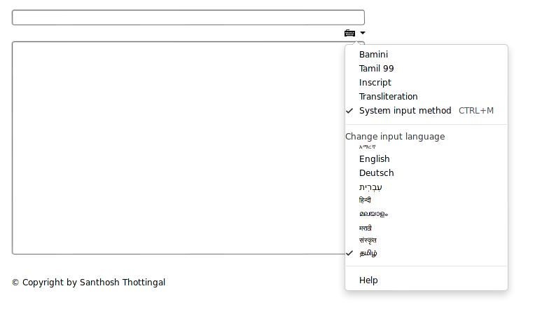
$( 'input' ).ime();

Slide 23
Selecting language
... is a problem when your use case requires selection from ~50+ languages
Wikimedia is introducing a new language selector - Universal Language Selector
Available as general purpose open source jQuery library

Slide 24
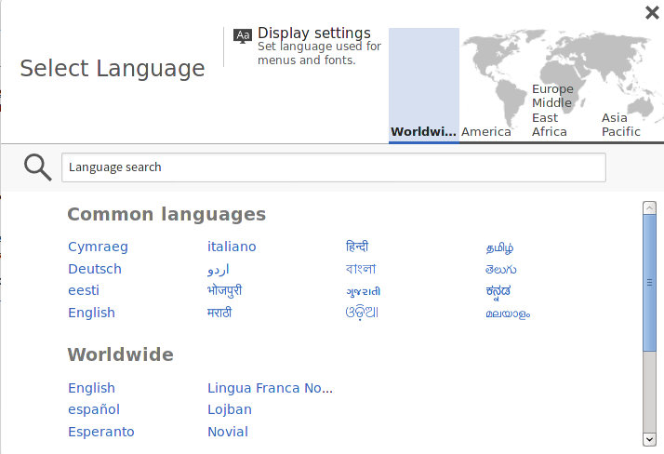

Slide 25
Use, Fork, Improve
github.com/wikimedia
We are hiring!
http://wikimediafoundation.org/wiki/Jobs
Internationalize your web applications using Wikimedia i18n libraries- Gnunify, Feb 2013, Pune.
Santhosh Thottingal. © CC-BY-SA

